Slide 1
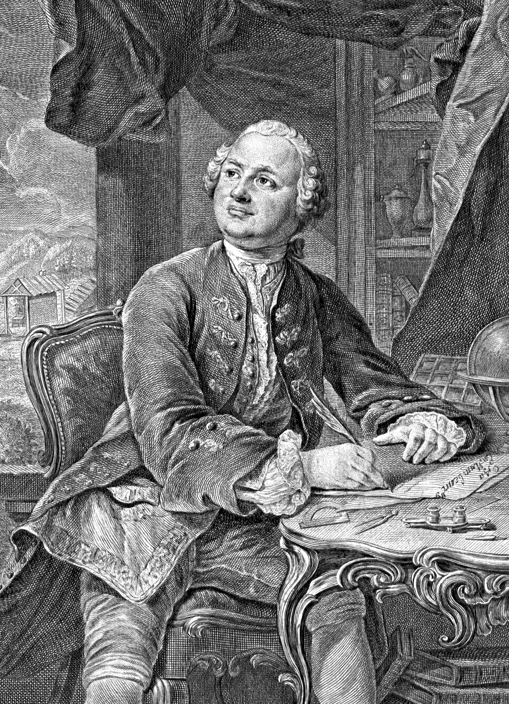
Mikhail Vasilyevich Lomonosov
«from rags to riches»

Slide 2
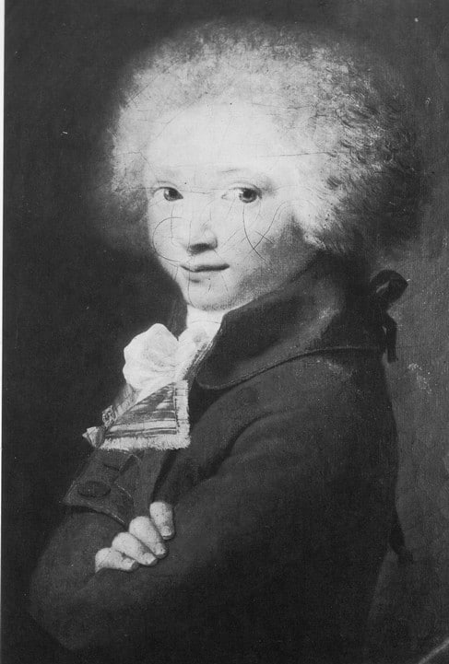
Childhood and youth
From an early age he was very fond of reading. He mastered his literacy under the guidance of a local sexton S. Sabelnikov, who taught him grammar, algebra, and instilled a love of literature.

Slide 3
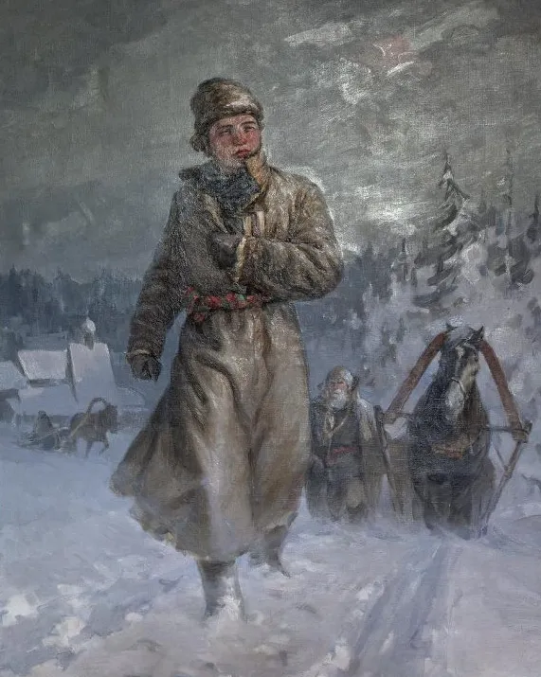
Path road
Lomonosov, with simple belongings consisting of two shirts, a sheepskin coat and several books, ran away from home at night. They walked for three days, and only after that they came across a caravan. He invited himself to the fishermen and they allowed the guy to travel with them.

Slide 4
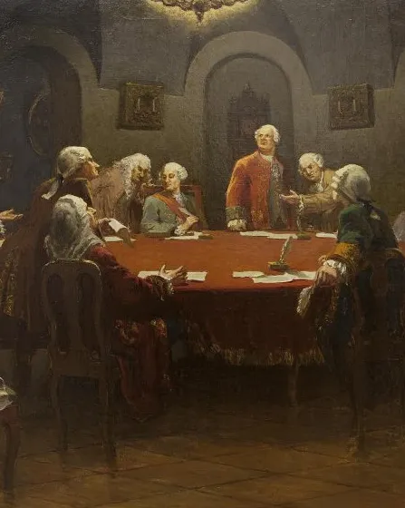
Granite of Science
For five years Mikhail lived abroad, and all these years he and his comrades were haunted by problems and troubles. The Academy of Sciences did not transfer money on time, so the students lived practically in debt. His first place of study was Marburg, and he finished his studies in Freiberg.

Slide 5
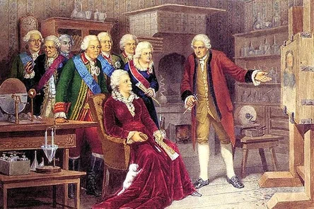
from rags to riches
In his biography there was a dissertation on the topic "Metallic luster". In 1745, it was this scientific development that brought him fame and the title of professor. And as a consequence of scientific achievements, he was made a nobleman.

Slide 6
Thanks for your attention

